Slide 1

Explainable AI-Driven Multimodal Analytics for Sustainable Smart City Decision Intelligence
Under the Guidance
Of
Dr K Swapnika
Batch No: 04
Team Members:
Pathi Sharmila-2420030042
Lakshman Angara-2420030067
Ivaturi Vennela-2420030185
Vishnu Priya Kodali-2420030630

Slide 2
Problem Statement
Rapid urbanization has created interconnected challenges such as increasing air pollution, changing weather conditions, and rising energy consumption. Existing analytical solutions often study these domains independently, making it difficult to understand their relationships and provide comprehensive insights for sustainable urban planning. Furthermore, machine learning models may provide predictions without clearly explaining the factors influencing their results. Therefore, there is a need for an integrated and explainable data analytics framework that can analyze environmental, weather, and energy-related data, generate reliable predictions, and provide understandable insights to support sustainable smart city decision-making.

Slide 3
Objectives
To develop an interactive analytics platform for analyzing air quality, weather, and energy consumption data to support sustainable smart-city decision-making.
To integrate air quality, weather, and energy consumption datasets to identify cross-domain relationships and meaningful patterns.
To enhance predictive analytics by incorporating Explainable AI (SHAP) to identify and interpret the key factors influencing environmental and energy predictions.
To evaluate and compare machine-learning models for environmental and energy prediction using appropriate performance metrics and identify the most effective models.

Slide 4
Literature Survey
Interpretable Machine Learning Framework for Air Quality Prediction in Istanbul using SHAP (2026)
Develops ML models for predicting major air pollutants and uses SHAP to identify how meteorological and pollutant variables influence predictions.
https://link.springer.com/article/10.1007/s00477-026-03168-4
Deep Learning-Based AQI Forecasting: A CNN-LSTM Model with Visual insights from SHAP-LIME and PDP (2025)
Uses a CNN-LSTM model for AQI forecasting and applies SHAP, LIME, and PDP to explain the factors affecting predictions.
https://link.springer.com/article/10.1007/s42452-025-07845-x
Scalable AI-Driven Air Quality Forecasting and Classification for Public Health Applications (2025)
Combines ML/DL models with meteorological data for air-quality forecasting and uses SHAP and LIME to provide interpretable results.
https://link.springer.com/article/10.1007/s44292-025-00052-8
Machine Learning Model for Predicting Long-Term Energy Consumption in Buildings (2025)
Compares XGBoost, SVR, and LSTM models for predicting long-term building energy consumption and evaluates their forecasting performance.
https://link.springer.com/article/10.1007/s43926-025-00115-7

Slide 5
Literature Survey
Air Quality Forecasting Using Machine Learning: Comparative Analysis and Ensemble Strategies for Enhanced Prediction (2025)
Compares multiple machine-learning models, including XGBoost, Random Forest, CatBoost, and LightGBM, for improved air-quality prediction.
https://link.springer.com/article/10.1007/s11270-025-08122-8
Comprehensive Evaluation of Machine Learning Models for Real-World Air Quality Prediction and Health Risk Assessment by AirQ+ (2025)
Evaluates different ML models for particulate-matter prediction using pollutant and meteorological variables, with applications to health-risk assessment.
https://link.springer.com/article/10.1007/s12145-025-01941-7
Smart Cities, Hot Cities: ML-Based Forecasting of Urban Heat Patterns (2025)
Applies machine learning to forecast urban temperature patterns and uses SHAP to explain the influence of climatic and temporal factors.
https://link.springer.com/article/10.1007/s43621-025-02059-y
Explainable Energy Consumption and Speed Prediction in Sustainable Cities Using Deep Learning (2025)
Uses deep-learning techniques to predict energy consumption and incorporates Explainable AI to interpret the model's predictions.
https://link.springer.com/article/10.1007/s00521-024-10850-7

Slide 6
Literature Survey
A Machine Learning-Powered Energy Consumption Prediction System with API (2025)
Develops an ML-based energy prediction system with an API, demonstrating how predictive models can be integrated into practical applications.
https://link.springer.com/article/10.1186/s43067-025-00242-9
State-of-the-Art and Emerging Trends in Deep Learning for Air Quality Forecasting and Health Impact Modeling (2025)
Reviews recent deep-learning approaches for air-quality forecasting and examines emerging technologies for environmental and health-impact monitoring.
https://ieeexplore.ieee.org/abstract/document/11410867

Slide 7
Research Gap Identification
Limited Multi-Domain Integration: Existing studies mainly focus on individual domains such as air quality, weather/climate, or energy consumption rather than analyzing them together.
Limited Cross-Domain Insights: Relationships between environmental conditions, weather factors, and energy consumption are not sufficiently explored within a unified analytical framework.
Limited Explainability Across Domains: Although SHAP and other XAI techniques are used in individual prediction tasks, their use across an integrated multi-domain framework is less explored.
Limited Unified Decision Support: Existing solutions often provide predictions or domain-specific dashboards, but there is scope for a single platform combining prediction, explanation, comparison, and visualization for sustainable smart-city decision-making.

Slide 8
Innovation
Multi-domain Analytics: Integrates Air Quality, Weather, and Energy Consumption data to study interconnected urban patterns rather than analyzing each domain independently.
Comparative Machine Learning: Develops and compares multiple regression models to identify suitable predictive approaches for environmental and energy-related analysis.
Explainable Predictions: Uses SHAP (SHapley Additive Explanations) to identify the important factors influencing model predictions, making the results easier to interpret.
Integrated Decision Support: Combines predictions, model explanations, trends, and visual analytics within a single interactive platform to support data-driven urban decisions.
Future Extensibility: The framework can be extended with additional datasets, real-time data sources, advanced ML/DL models, and other smart-city applications in later phases.

Slide 9
Feasibility
Dataset Feasibility: The project uses publicly available Air Quality, Weather, and Energy Consumption datasets, making data collection practical and reducing the need for costly data acquisition.
Technical Feasibility: The required technologies, including Python, Pandas, NumPy, Scikit-learn, XGBoost, SHAP, and Streamlit, are well-established and suitable for implementing the proposed analytics pipeline.
Methodological Feasibility: The project uses established techniques for preprocessing, EDA, feature engineering, machine learning, model evaluation, Explainable AI, and visualization rather than requiring development of entirely new algorithms.
Implementation Feasibility: The system can be developed incrementally, allowing individual components such as data processing, prediction, explainability, and visualization to be implemented and tested separately.
Time Feasibility: The project is suitable for phase-wise development from 3-1 to 4-1, allowing sufficient time for experimentation, validation, improvements, and final integration.

Slide 10
Project Plan
Phase 1 – Data Preparation: Collect and understand the three benchmark datasets, perform data cleaning, integration, missing-value handling, outlier treatment, and exploratory data analysis.
Phase 2 – Feature & Predictive Analytics: Perform feature engineering and selection, develop the selected regression models, and compare their performance using appropriate evaluation metrics.
Phase 3 – Explainable AI & Visualization: Apply SHAP to interpret the important factors behind model predictions and develop meaningful visualizations for environmental and energy trends.
Phase 4 – Integrated Dashboard: Combine predictions, explanations, comparative results, and visual analytics into an interactive dashboard for sustainable smart-city decision support.
Phase 5 – Validation & Research Output: Validate the complete system, improve model performance where required, document the findings, prepare the final project, and develop the work into a research-paper-ready outcome.

Slide 11
Methodology
1. Data Collection & Preparation
Collection of Air Quality, Weather and Energy Consumption datasets.
Initial inspection of shape, data types, missing values, duplicates and statistical characteristics.
Dataset-specific cleaning, including handling missing values, duplicate records, invalid values and irrelevant attributes.
Storage of cleaned datasets for further analysis.
2. Exploratory Data Analysis
Univariate analysis to study distributions, frequencies and outliers.
Bivariate analysis to identify relationships between important variables.
Multivariate analysis to understand interactions among multiple features.
Correlation analysis and heatmaps to identify relationships and redundant features.
EDA graphs are saved for analysis and research-paper documentation.
3. Feature Engineering
Creation of meaningful domain-specific features from the cleaned datasets.
Air Quality: PM Ratio, NOx/NO2 Ratio, CO/CO2 Ratio, Pollution Score and Pollution Level.
Weather: Year, Month, Hour, Day of Week, Season, Temperature Difference and Wind-Chill Indicator.
Energy: Hour, Month, Weekend, HVAC Status, Lighting Status and energy-related indicators.

Slide 12
Methodology
4. Feature Selection & Leakage Prevention
Selection of relevant features using correlation, redundancy and domain relevance.
Removal of highly correlated or unnecessary features.
Identification and removal of features that directly use the target variable.
Separate leakage-safe feature sets are prepared for each prediction task.
5. Predictive Modeling
Numerical and categorical features are processed using appropriate imputation, scaling and encoding techniques.
Training and testing datasets are prepared using an 80:20 split, with chronological splitting for Weather data.
Linear Regression, Decision Tree Regression and Random Forest Regression are trained for all three domains.
Model predictions are generated on unseen test data.
6. Model Evaluation & Selection
Models are evaluated using MAE, MSE, RMSE and R² Score.
Performance of the three algorithms is compared independently for each domain.
The best-performing baseline model is selected for Air Quality, Weather and Energy.
The selected models are saved for further hybrid modeling and deployment.

Slide 13
Methodology
7. Proposed Hybrid Modeling
The selected baseline model first generates the domain prediction.
The residual error between actual and predicted values is calculated.
A secondary model learns the patterns in these residual errors.
The predicted residual is added to the base prediction to obtain the hybrid prediction.
Baseline and hybrid models are compared to determine whether prediction accuracy improves.
8. Explainability & Error Analysis
SHAP is applied to identify the contribution of individual features to model predictions.
Feature-importance and SHAP summary visualizations are generated for each domain.
Residual analysis is used to examine remaining prediction errors.
The combined analysis provides an error-aware explanation of model behavior.
9. Decision Support & Dashboard
Integrated predictions are converted into interpretable smart-city conditions using justified criteria.
Relevant decision-support information and recommendations are generated.
A Streamlit dashboard provides interactive prediction and visualization for all three domains.
Predictions, model performance and SHAP explanations are presented through the dashboard.

Slide 14
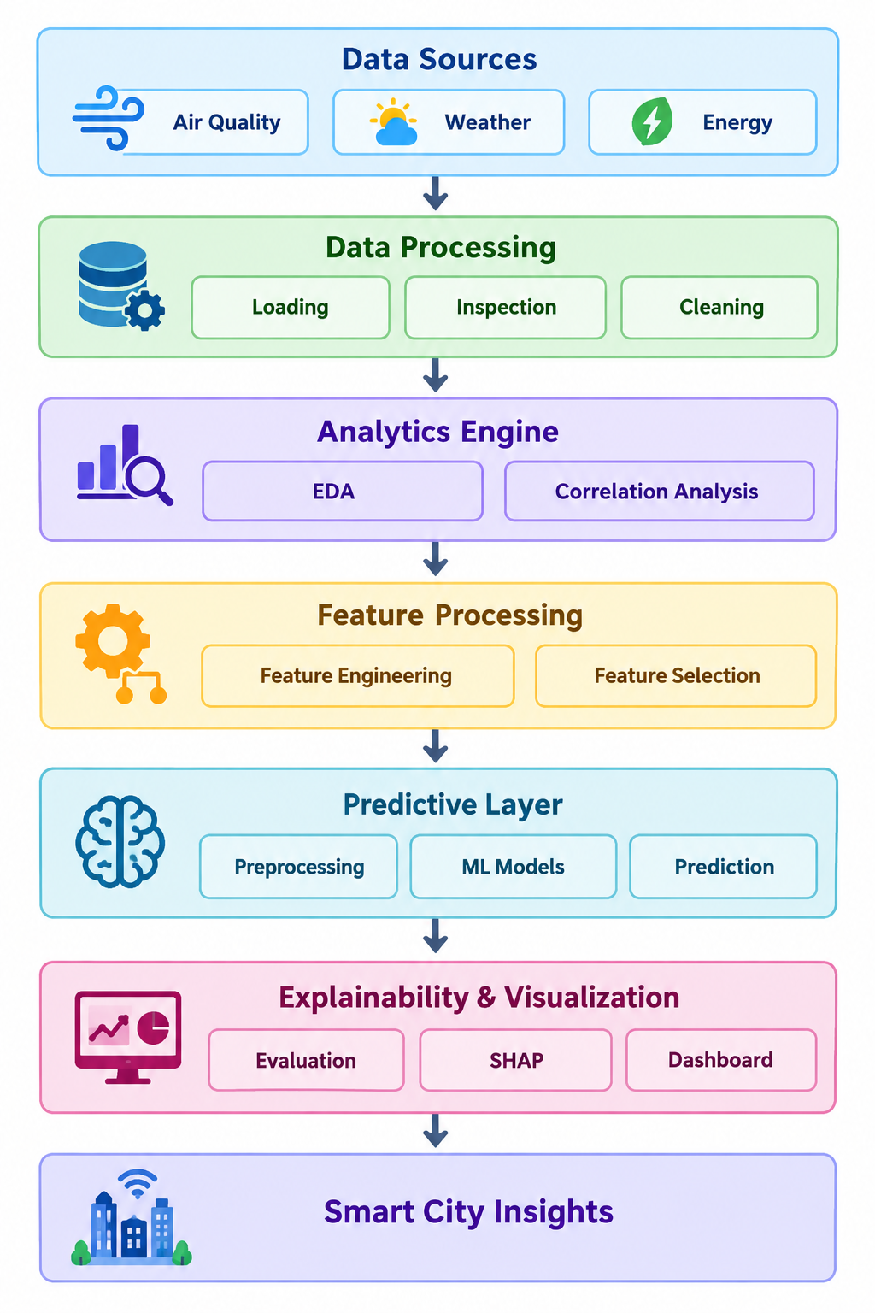
System Design
Data Sources
Air Quality | Weather | Energy
↓
Data Processing
Loading | Inspection | Cleaning
↓
Analytics Engine
EDA | Correlation Analysis
↓
Feature Processing
Feature Engineering | Feature Selection
↓
Predictive Layer
Preprocessing | ML Models | Prediction
↓
Explainability & Visualization
Evaluation | SHAP | Dashboard
↓
Smart City Insights

Slide 15
Modern Tools & Technologies
Category | Tool / Technology | Purpose in the Project
Programming Language | Python | Core language for data analysis, preprocessing and project implementation
Development Environment | Jupyter Notebook | Interactive development, analysis and experimentation
Development Environment | PyCharm | Organized project implementation and management
Data Processing | Pandas | Data loading, cleaning, transformation and analysis
Numerical Computing | NumPy | Numerical operations and array-based computation
Data Visualization | Matplotlib | Histograms, box plots and analytical visualizations
Data Visualization | Seaborn | Statistical plots, correlation analysis and heatmaps
Data Storage | CSV | Storage and handling of the project datasets
Machine Learning | Scikit-learn | Model development, prediction and performance evaluation
Explainable AI | SHAP | Interpretation and explanation of machine-learning predictions
Dashboard / Visualization | Interactive Dashboard | Presentation of analytical insights and model results

Slide 16
Results
Data Cleaning
Successfully cleaned all three datasets by handling missing values, duplicates, and invalid records.
Generated clean datasets ready for analysis.
EDA Findings
Identified important data distributions, patterns, outliers, and correlations.
Detected highly correlated and redundant features.
Feature Engineering
Created meaningful domain-specific features for Air Quality, Weather, and Energy datasets.
Feature Selection
Reduced feature redundancy using correlation analysis (|r| > 0.85).
Identified and avoided potential target leakage.
Final Outcome:
Cleaned Data → EDA Insights → Engineered Features → Selected Features → Ready for Predictive Modeling

Slide 17
Performance Evaluation
The predictive models will be evaluated and compared based on their ability to generate accurate and reliable predictions.
MAE: Measures average prediction error.
MSE: Penalizes larger errors more heavily.
RMSE: Measures error in the target’s original scale.
R² Score: Measures how well the model explains the target variation.
Model Comparison:
Different ML models will be trained and compared using these metrics.
Final Selection:
The best-performing model will be selected for prediction and explainability.
Flow:
Selected Features → Model Training → Prediction → Evaluation → Best Model

Slide 18
Implementation of the proposed hybrid model
1.Architecture of the LCG-Stack Model
Base Learners: Combines three complementary algorithms—Linear Regression (LR) for global linear trends, CatBoost (CB), and Gradient Boosting (GB) for complex non-linear relationships across heterogeneous urban datasets.
Meta-Learner: Employs a Linear Regression meta-learner to weigh and aggregate the predictions from the base learners into a final robust output.
2. Training & Validation Workflow
Out-of-Fold (OOF) Stacking Strategy: Implemented using a 5-fold cross-validated OOF procedure on the training data. Base-model predictions are generated iteratively to prevent data leakage and target overfitting before feeding them to the meta-learner.
Dataset Splitting: Data across air quality, weather, and energy domains were structured and divided into consistent training and testing subsets (80:20 split with random state 42) for reproducible evaluation. .

Slide 19
3. Implementation Environment & Integration
Tech Stack: Developed in Python using Scikit-learn (for preprocessing, baseline regression, and the Linear Regression meta-learner), CatBoost, and Gradient Boosting libraries, with Pandas and NumPy for data manipulation.
Artifact Management & Deployment: Trained models and preprocessing pipelines are serialized using Joblib, and fully integrated into an interactive Streamlit dashboard for real-time visualization, explainability, and decision support

Slide 20
Experiments using the prescribed dataset(s)
Air Quality Dataset — 500 records, used for Pollution Score prediction.
Synthetic Weather Dataset — 96,429 records, used for Temperature prediction.
Energy Consumption Dataset — 1,000 records, used for Energy Consumption prediction.
Performed data preprocessing, exploratory data analysis, feature engineering, and feature selection for each dataset.
Evaluated Linear Regression, Decision Tree, and Random Forest as baseline models.
Developed the proposed LR–CatBoost–Gradient Boosting stacking ensemble using 5-fold Out-of-Fold (OOF) stacking with a Linear Regression meta-learner.
Evaluated models using MAE, MSE, RMSE, R², Median Absolute Error, Explained Variance, Maximum Error, NRMSE, Adjusted R², and MAPE where applicable.
Applied SHAP-based global and instance-level explainability to the proposed hybrid model.

Slide 21
Training and Testing Results
The datasets were divided into training and testing sets for model development and independent evaluation.
Air Quality: 400 training records and 100 testing records.
Weather: 77,143 training records and 19,286 testing records.
Energy: 800 training records and 200 testing records.
Baseline models and the proposed hybrid model were evaluated on the held-out test sets.
Performance was assessed using MAE, MSE, RMSE, and R², along with additional evaluation metrics.
The results showed domain-dependent model performance; the proposed hybrid model was competitive but did not consistently outperform all baseline models.

Slide 22
Comparison with relevant existing models from the literature
ID | Hybrid / Model | Main idea | Energy RMSE | Energy R² | Decision
C4 | Weather–Energy Fusion + Contextual Interactions | Energy prediction enhanced using Weather context | 5.3271 | 0.5667 | Rejected
C4-v2 | Weather–Energy Fusion + Interactions | Adds interaction features | 5.5513 | 0.5295 | Rejected
C7 | Weather–Energy Alignment + LR/RF | Leakage-safe weather-energy fusion | 5.2798 | 0.5744 | Rejected
C8 | Air + Weather + Energy Context | 3-domain contextual prediction | 5.2788 | 0.5746 | Rejected
C9 | RF → XGBoost Residual | RF prediction corrected using XGBoost residual model | 5.7466 | 0.4958 | Rejected
C10 | Standalone XGBoost | Gradient-boosting candidate | 5.4896 | 0.5399 | Rejected
C11 | XGBoost + MLP/DNN | Tree model + neural network | 5.4814 | 0.5413 | Rejected
C12-LR | Leakage-safe Weather–Energy Fusion + LR | Cross-domain fusion | 5.2738 | 0.5754 | Rejected
C12-RF | Leakage-safe Weather–Energy Fusion + RF | Same fusion with RF | 5.5959 | 0.5219 | Rejected
C13 | ExtraTrees + RF OOF Stack | Tree-based stacking | 5.4618 | 0.5446 | Rejected

Slide 23
Comparison with relevant existing models from the literature
ID | Hybrid / Model | Main idea | Energy RMSE | Energy R² | Decision
C14-P | Polynomial Ridge | Nonlinear polynomial + Ridge | 5.6812 | 0.5072 | Rejected
C14-SVR | SVR | Kernel-based nonlinear regression | 5.6938 | 0.5051 | Rejected
C14-HGB | HistGradientBoosting | Histogram gradient boosting | 5.6480 | 0.5130 | Rejected
HRLM-W | LR + RF Residual — Weather | Residual correction | 3.7284 | 0.8276 | Rejected later
HRLM-E | LR + RF Residual — Energy | Residual correction | 5.4333 | 0.5493 | Rejected
LR + CB | LR + CatBoost OOF Stack | Linear + nonlinear stacking | 5.1737 | 0.5913 | Rejected
LR + GB | LR + Gradient Boosting OOF Stack | Linear + boosting stacking | 5.2029 | 0.5867 | Rejected
LR + CB + RF | 3-model OOF Stack | LR + CatBoost + RF | 5.1778 | 0.5907 | Rejected
75/25 Blend | LR–CatBoost weighted blend | Fixed weighted ensemble | — | 0.5917 | Rejected
LCG-Stack | LR + CatBoost + GB + LR Meta | OOF stacking | 5.1543 | 0.5944 | FINAL

Slide 24
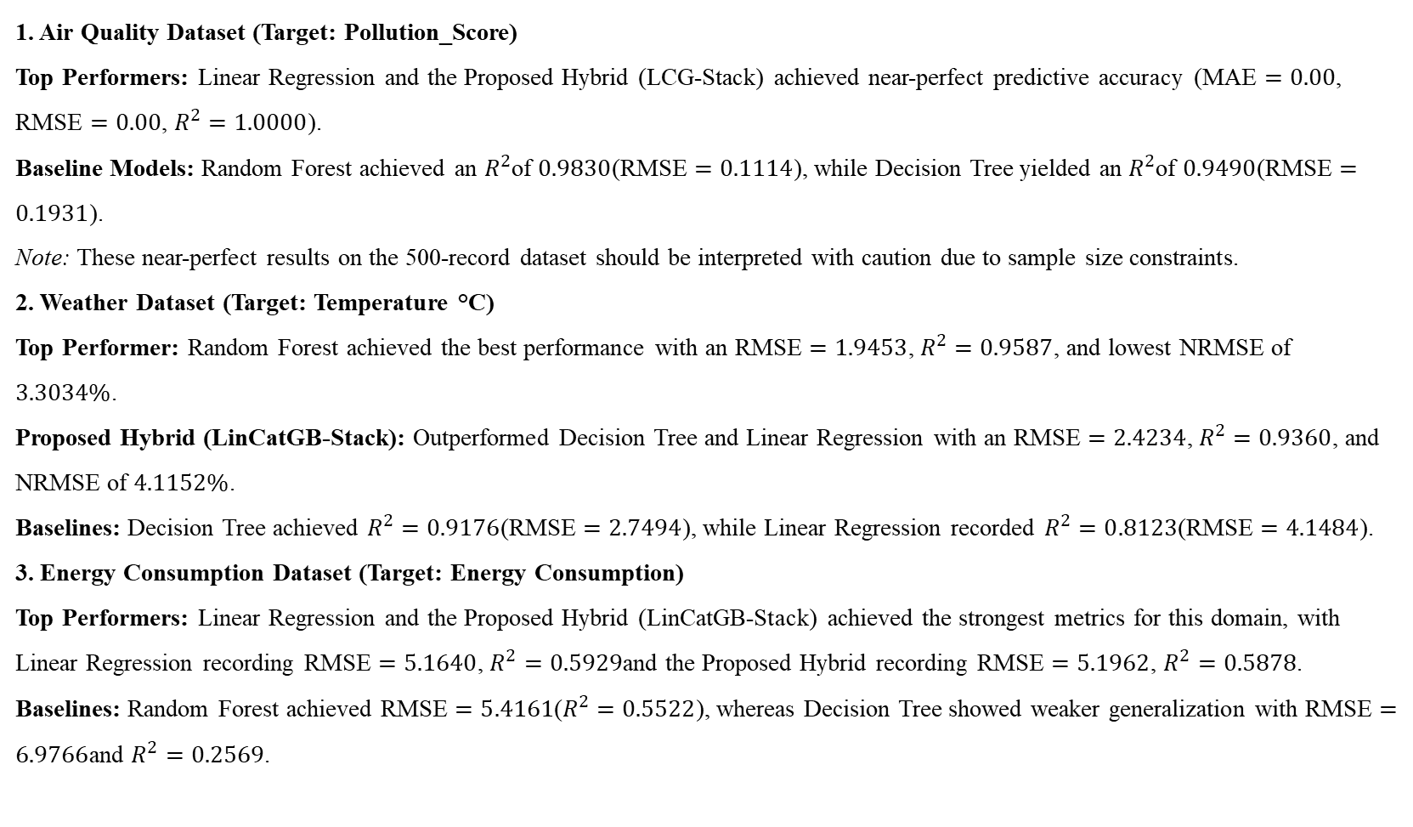
Performance metrics and comparative results
1. Air Quality Dataset (Target: Pollution_Score)
Top Performers: Linear Regression and the Proposed Hybrid (LCG-Stack) achieved near-perfect predictive accuracy ($\text{MAE}=0.00$, $\text{RMSE}=0.00$, $R^{2}=1.0000$).
Baseline Models: Random Forest achieved an $R^{2}$of $0.9830$($\text{RMSE}=0.1114$), while Decision Tree yielded an $R^{2}$of $0.9490$($\text{RMSE}=0.1931$).
Note: These near-perfect results on the 500-record dataset should be interpreted with caution due to sample size constraints.
2. Weather Dataset (Target: Temperature °C)
Top Performer: Random Forest achieved the best performance with an $\text{RMSE}=1.9453$, $R^{2}=0.9587$, and lowest NRMSE of $3.3034\%$.
Proposed Hybrid (LinCatGB-Stack): Outperformed Decision Tree and Linear Regression with an $\text{RMSE}=2.4234$, $R^{2}=0.9360$, and NRMSE of $4.1152\%$.
Baselines: Decision Tree achieved $R^{2}=0.9176$($\text{RMSE}=2.7494$), while Linear Regression recorded $R^{2}=0.8123$($\text{RMSE}=4.1484$).
3. Energy Consumption Dataset (Target: Energy Consumption)
Top Performers: Linear Regression and the Proposed Hybrid (LinCatGB-Stack) achieved the strongest metrics for this domain, with Linear Regression recording $\text{RMSE}=5.1640$, $R^{2}=0.5929$and the Proposed Hybrid recording $\text{RMSE}=5.1962$, $R^{2}=0.5878$.
Baselines: Random Forest achieved $\text{RMSE}=5.4161$($R^{2}=0.5522$), whereas Decision Tree showed weaker generalization with $\text{RMSE}=6.9766$and $R^{2}=0.2569$.

Slide 25
Comparison of multiple hybrid combinations
Proposed Hybrid Architecture (LCG-Stack)
Base Learners: Combines Linear Regression (LR), CatBoost (CB), and Gradient Boosting (GB) to capture both linear trends and complex non-linear relationships across heterogeneous urban datasets.
Meta-Learner: Uses a Linear Regression meta-learner to aggregate predictions from the base models.
Validation Strategy: Implemented using a 5-fold out-of-fold (OOF) stacking procedure to prevent data leakage and ensure robust generalization during training.
Domain-Wise Comparative Model Configurations
Air Quality Dataset (Target: Pollution_Score): Evaluated baseline models (Linear Regression, Decision Tree, Random Forest) alongside the LCG-Stack configuration using out-of-fold predictions.
Weather Dataset (Target: Temperature °C): Evaluated baseline models alongside the LCG-Stack configuration, noting that standalone Random Forest achieved superior predictive performance.
Energy Consumption Dataset (Target: Energy Consumption): Evaluated baseline models alongside the LCG-Stack configuration, comparing linear and tree-based ensemble combinations.

Slide 26
Justification for selecting the final hybrid model
1. Complementary Architectural Strengths
Combining Linear and Non-Linear Learners: The Out-of-Fold Linear–CatBoost–Gradient Boosting Stacking Ensemble (LCG-Stack) integrates models with diverse inductive biases. Linear Regression captures global linear trends, while CatBoost and Gradient Boosting effectively model complex, non-linear interactions inherent in urban environmental and energy data.
2. Mitigation of Overfitting and Information Leakage
Out-of-Fold (OOF) Stacking Strategy: A 5-fold cross-validated OOF procedure was used to generate predictions from the base learners before feeding them into the Linear Regression meta-learner. This prevents target leakage and ensures that the meta-learner generalizes effectively to unseen test data.
3. Multi-Domain Adaptability and Robustness
Unified Analytical Framework: Rather than relying on a single algorithm type, the stacking framework provides a structured architecture capable of handling heterogeneous smart-city domains (air quality, historical weather, and energy consumption) with consistent preprocessing and evaluation pipelines.
4. Transparent Integration with Explainable AI (XAI)
Synergy with SHAP: The model architecture maintains compatibility with SHAP (SHapley Additive exPlanations), enabling both global feature importance rankings and instance-level explanations to interpret how base predictions are weighted and combined.

Slide 27
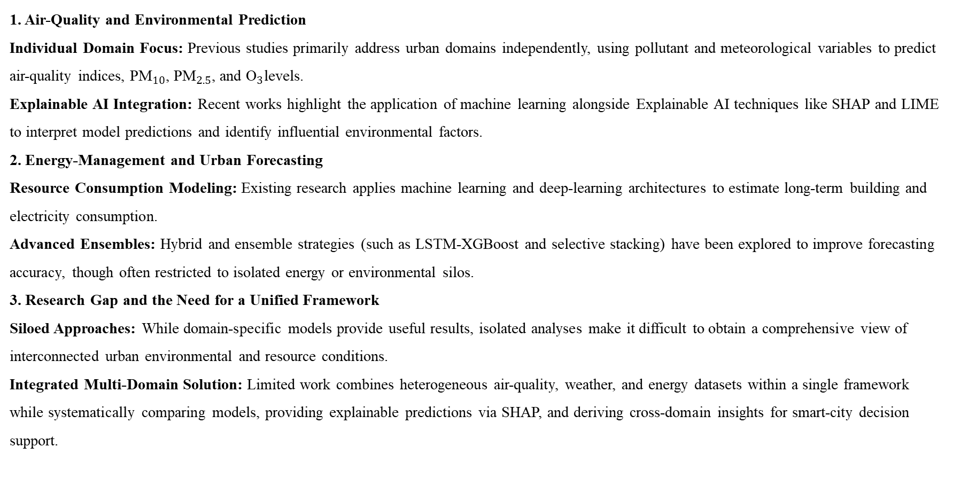
Literature Review
1. Air-Quality and Environmental Prediction
Individual Domain Focus: Previous studies primarily address urban domains independently, using pollutant and meteorological variables to predict air-quality indices, ${\text{PM}}_{10}$, ${\text{PM}}_{2.5}$, and ${\text{O}}_{3}$levels.
Explainable AI Integration: Recent works highlight the application of machine learning alongside Explainable AI techniques like SHAP and LIME to interpret model predictions and identify influential environmental factors.
2. Energy-Management and Urban Forecasting
Resource Consumption Modeling: Existing research applies machine learning and deep-learning architectures to estimate long-term building and electricity consumption.
Advanced Ensembles: Hybrid and ensemble strategies (such as LSTM-XGBoost and selective stacking) have been explored to improve forecasting accuracy, though often restricted to isolated energy or environmental silos.
3. Research Gap and the Need for a Unified Framework
Siloed Approaches: While domain-specific models provide useful results, isolated analyses make it difficult to obtain a comprehensive view of interconnected urban environmental and resource conditions.
Integrated Multi-Domain Solution: Limited work combines heterogeneous air-quality, weather, and energy datasets within a single framework while systematically comparing models, providing explainable predictions via SHAP, and deriving cross-domain insights for smart-city decision support.

Slide 28
Literature-based novelty verification
1. Limitation of Existing Single-Domain Studies
Isolated Focus: Prior research (e.g., Birinci et al., 2026; Mohapatra et al., 2025; Hussien et al., 2025) focuses heavily on siloed prediction tasks, addressing individual smart-city domains such as air quality, weather analysis, or building energy consumption independently.
Lack of Integration: Existing approaches rarely integrate heterogeneous environmental, meteorological, and energy datasets within a single, unified analytical framework.
2. Gap in Model Selection and Explainability
Performance vs. Interpretability Trade-off: While advanced ensemble and deep-learning models (e.g., CNN-LSTM, LSTM-XGBoost hybrids) have been proposed to improve predictive performance, they often lack systematic comparative evaluation, out-of-fold stacking safeguards against leakage, and comprehensive multi-domain explainability.
Limited Decision Support: Many studies emphasize predictive accuracy alone without providing actionable, cross-domain insights or interactive decision-support interfaces for urban planners.
3. Our Novelty & Contributions
Unified Multi-Domain Framework: Successfully integrates air-quality, weather, and energy-consumption data within a single end-to-end workflow.
Robust Hybrid Stacking: Introduces the Out-of-Fold Linear–CatBoost–Gradient Boosting Stacking Ensemble (LCG-Stack) with a Linear Regression meta-learner to balance linear and non-linear patterns.
Explainable AI & Interactive Dashboard: Applies SHAP-based global and instance-level explanations alongside an interactive Streamlit dashboard to bridge the gap between machine-learning outputs and practical smart-city decision intelligence.

Slide 29
Thank You

